Slide 1
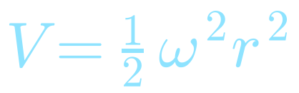
Project 5 · Fall Semester 2020
Quantum Monte Carlo of Confined Electrons
Variational Monte Carlo for a two-electron quantum dot in three dimensions
e₁
e₂
Amey S. Yadav Atharva Goyal

Slide 2
Index
1
Problem Statement
2
Theory
3
Methodology
4
Project Tasks
5
Results

Slide 3

01
Problem Statement
Aim, goals and the two-electron quantum dot

Slide 4



Problem Statement
WE CALCULATE
The aim
Ground-state energy and its variance
Use Variational Monte Carlo (VMC) to study two electrons confined in a three-dimensional harmonic oscillator trap, a quantum dot, including the repulsive Coulomb interaction.
Mean distance ⟨r₁₂⟩ between the electrons
Effect of electron correlation
Quantum dots are a lively research area in condensed matter and materials science, with applications from quantum circuits to solar cells and nanomedicine.

Slide 5


The Physical System
Total Hamiltonian, N = 2 electrons in 3D
Oscillator part H₀
Repulsion H₁
Atomic units
ħ = c = e = m = 1, so distances are dimensionless and energies are in a.u.
for each electron. This part is solved exactly.
The Coulomb term above couples the two electrons.

Slide 6
02
Theory
Benchmark, trial wave functions, local energy

Slide 7



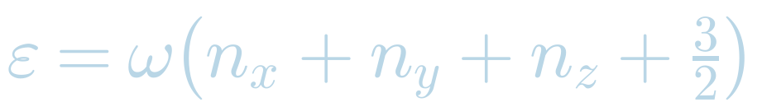
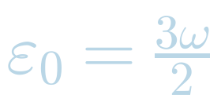
Non-Interacting Benchmark
General wave function
Two non-interacting electrons
H_{n} are Hermite polynomials and A is a normalisation constant.
One electron in the trap
Ground-state energy E = 3ω, exactly 3 a.u. at ω = 1. This is the first benchmark for the code.
Energy levels; the lowest state has n_{x} = n_{y} = n_{z} = 0.
The spatial wave function is symmetric under exchange, so the spin part must be antisymmetric: a singlet.

Slide 8



Trial Wave Functions
Trial function 1 · no correlation
Trial function 2 · Jastrow factor
One variational parameter, α. The function depends only on r₁ and r₂, so it cannot describe the correlation between the electrons.
Two variational parameters, α and β. As r₁₂ → 0 the logarithmic derivative of the Jastrow factor tends to the cusp value for electrons with opposite spins:
Cusp condition: not satisfied
Cusp condition: satisfied

Slide 9
Local Energy
Ψ_{T1} without Coulomb term
Ψ_{T1} with Coulomb repulsion
Gives the exact result 3ω at α = 1.
Baseline for judging the second trial function.
Ψ_{T2} with Coulomb repulsion

Slide 10
03
Methodology
Variational Monte Carlo and Metropolis sampling

Slide 11



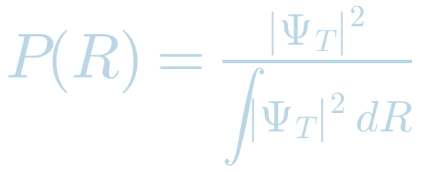

Variational Monte Carlo
Energy expectation value
Metropolis algorithm
Propose a move R′ = R + δ · r, with r a uniform random number.
Accept it with probability min[1, w], where
Add E_{L} and E_{L}² to the running sums.
Repeat for all Monte Carlo cycles and average.
are the probability density and the local energy.
Write an algorithm to tune the step length δ for each α so that about 50 % of the moves are accepted.

Slide 12
Algorithm Overview
1
2
3
4
5
Input
Initialise
Metropolis loop
Accumulate
Output
ω, α, β and the number of Monte Carlo cycles
Random start positions R and step length δ
Propose R′, then accept or reject with the |Ψ|² ratio
Local energy E_{L}, E_{L}² and r₁₂
⟨E⟩, variance σ² and mean distance ⟨r₁₂⟩
Outer parameter scans
Scan α (and later β) to find the energy and variance minima, then repeat for ω = 0.01, 0.5 and 1.0.

Slide 13
04
Project Tasks
Energy scan · Jastrow factor

Slide 14



First Trial Function
VMC with Ψ_{T1} only, total spin S = 0, for quantum dots with different oscillator frequencies.
Tune the step length
Scan the parameter α
Find the optimal δ for each α, giving roughly 50 % accepted moves.
Plot ⟨E⟩ and the variance against α, locate minima of ⟨E⟩
Check stability
Mean distance
Vary the number of Monte Carlo cycles.
Compute ⟨r₁₂⟩ at the energy minimum for ω = 0.01, 0.5 and 1.0, and comment.

Slide 15
Second Trial Function
Optimisation strategy for Ψ_{T2}
Compute at ω = 0.01, 0.5, 1.0
Start from the optimal α found.
Vary β to find the lowest energy.
Change α again, keeping the new β.
Repeat until the energy stops decreasing.
Optimal parameters α and β
Energy ⟨E⟩ and variance
Mean distance ⟨r₁₂⟩
The analytical local energy E_{L2} is used throughout.
Discuss
How important are the correlations from the Jastrow factor?

Slide 16
Discuss
Effect of the Jastrow factor
Weak versus strong trap
The Jastrow factor keeps the electrons apart, which lowers the Coulomb repulsion energy and so decreases E_{min}.
The same effect increases the mean separation ⟨r₁₂⟩ compared with Ψ_{T1}.
At ω = 0.01 the repulsion dominates the weak trap, so the correlations matter most.
At ω = 1.0 the trap dominates, so the effect of the correlations is smaller.
Reliability of the results
Spread between runs (standard deviation)
Each result comes from 100 loops of 5 million Monte Carlo steps.
Ψ_{T1} deviates from the analytical E_{min} by less than 6.49 × 10⁻⁴.
Ψ_{T1}: energy < 6.37 × 10⁻⁴, separation < 2.06 × 10⁻².
Ψ_{T2}: energy < 2.65 × 10⁻⁵, separation < 9.43 × 10⁻³.
Conclusion: the correlations are important. The Jastrow factor lowers the energy, increases the electron separation and gives much smaller run-to-run spread.

Slide 17
05
Results
Tables, plots, code checks and references

Slide 18
Results Summary
Quantity | ω = 0.01 | ω = 0.5 | ω = 1.0
Ψ_{T1}: optimal α | 0.437310 | 0.817296 | 0.878946
Ψ_{T1}: ⟨E⟩ (a.u.) | 0.093629 | 2.040659 | 3.773088
Ψ_{T1}: ⟨r₁₂⟩ | 24.130319 | 2.496515 | 1.702181
Ψ_{T2}: optimal α, β | 0.933212, 0.044802 | 0.996432, 0.199826 | 0.999145, 0.275797
Ψ_{T2}: ⟨E⟩ (a.u.) | 0.079295 | 2.000065 | 3.730192
Ψ_{T2}: ⟨r₁₂⟩ | 29.178112 | 2.684703 | 1.811207

Slide 19
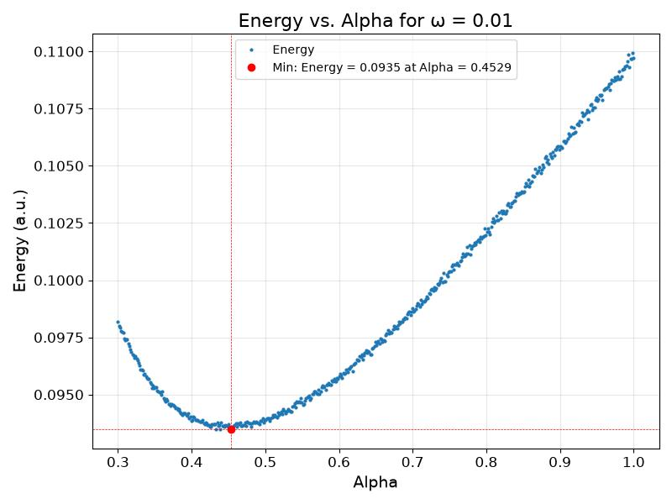
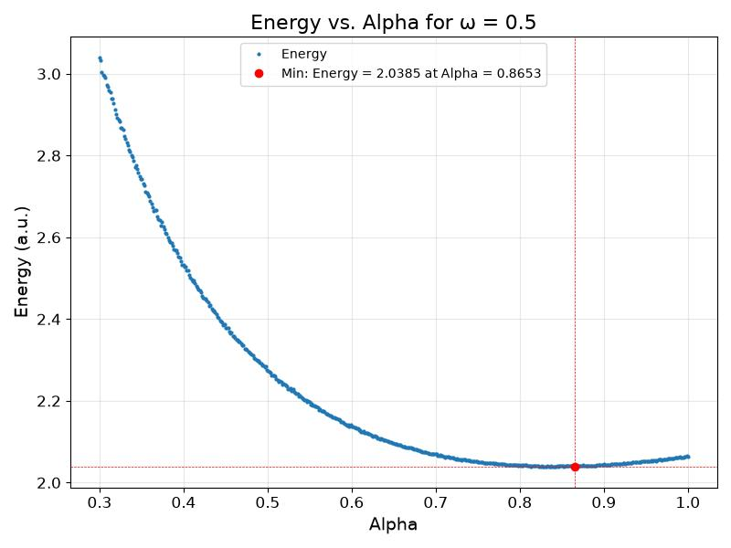
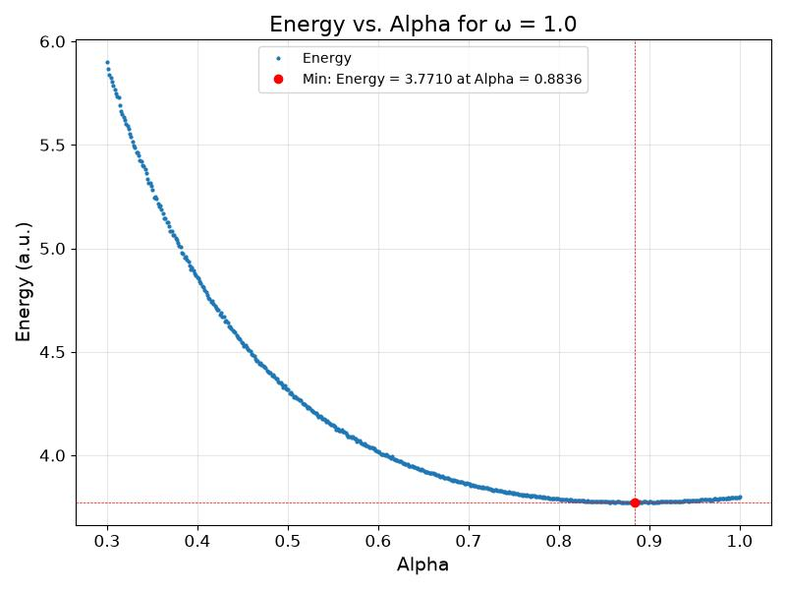
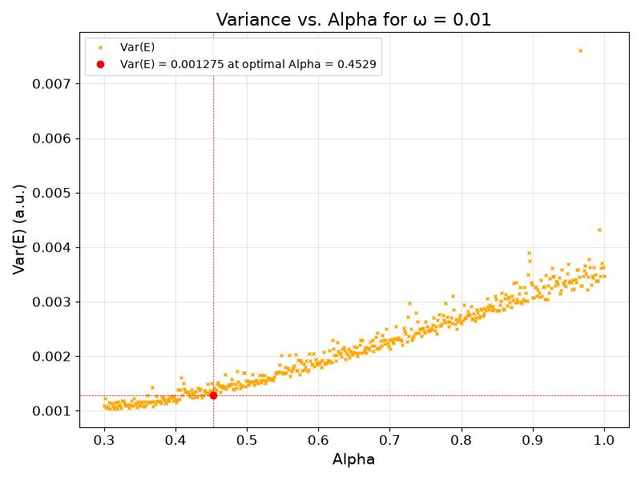
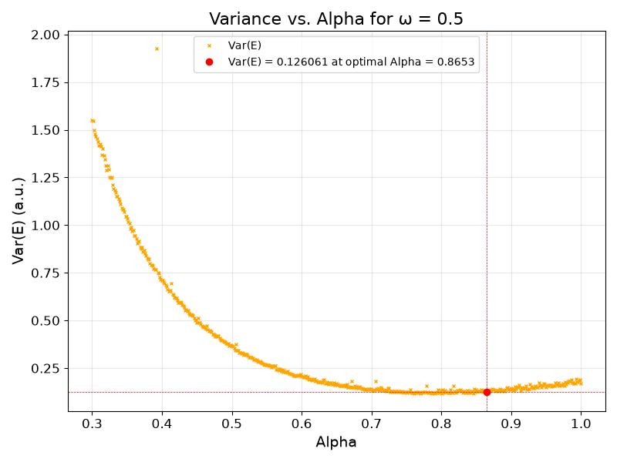
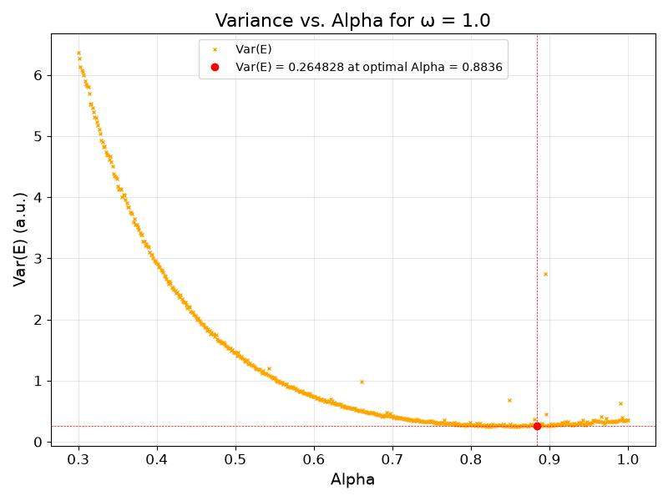
ENERGY AND VARIANCE GRAPHS FOR TRIAL FUNCTION 1

Slide 20
Code Checks and References
Checks built into the code
Deliverables
Non-interacting limit: ⟨E⟩ = 3ω, which is 3 a.u. at ω = 1.
At α = 1 without Coulomb term the local energy is constant, so the variance is zero.
Interacting case at ω = 1: compare with 3.558 a.u.
Acceptance rate close to 50 % after tuning δ.
PDF report with discussion, figures and tables
Source code on GitHub, with unit tests and a folder of selected results
References
M. Taut, Phys. Rev. A 48, 3561 (1993)
https:www2.ph.ed.ac.uk/~gja/qp/qp8.pdf

Slide 21
Link to GitHub repository
https://github.com/TheAtharva-Goyal/Quantum-Monte-Carlo-of-confined-electrons

Slide 22
Thank You
Any Questions?
Amey S. Yadav Atharva Goyal

